Slide 1
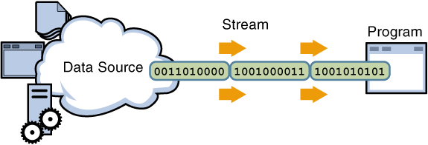
Streaming
Input Streams-ניתן לקלוט מהם בתים
OutputStream-ניתן לשלוח אליהם בתים

Slide 2
I/O
Usual Purpose: storing data to ‘nonvolatile‘ devices, e.g. harddisk
Classes provided by package java.io
Data is transferred to devices by ‘streams‘
output - stream
Program
Device
input - stream
Program
Device

Slide 3
Streams
JAVA distinguishes between 2 types of streams:
Text – streams, containing ‘characters‘
Program
I
‘
M
A
S
T
R
I
N
G
\n
Device
Binary Streams, containing 8 – bit information
Program
01101001
11101101
00000000
Device

Slide 4
Streams
Streams in JAVA are Objects, of course !
Having
2 types of streams (text / binary) and
2 directions (input / output)
results in 4 base-classes dealing with I/O:
Reader: text-input
Writer: text-output
InputStream: byte-input
OutputStream: byte-output

Slide 5
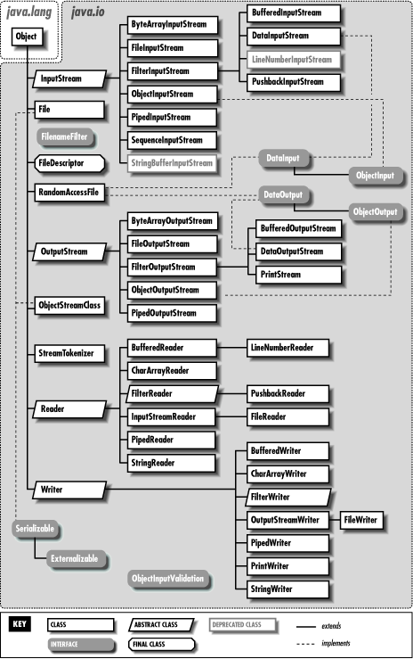
Streams
InputStream
OutputStream
Reader
Writer
binary
text

Slide 6
Streams
InputStream, OutputStream, Reader, Writer are abstract classes
Subclasses can be classified by 2 different characteristics of sources / destinations:
For final device (data sink stream)
purpose: serve as the source/destination of the stream
(these streams ‘really’ write or read !)
for intermediate process (processing stream)
Purpose: alters or manages information in the stream
(these streams are ‘luxury’ additions, offering methods for convenient
or more efficient stream-handling)

Slide 7
I/O: General Scheme
In General:
Reading (writing):
open an input (output) stream
while there is more information
read(write) next data from the stream
close the stream.
In JAVA:
Create a stream object and associate it with a disk-file
Give the stream object the desired functionality
while there is more information
read(write) next data from(to) the stream
close the stream.

Slide 8
Example 1
Writing a text file:
Create a stream object and associate it with a disk-file
Give the stream object the desired functionality
write data to the stream
close the stream.

Slide 9
Writing Textfiles
Class: FileWriter
Frequently used methods:

Slide 10
Writing Text files
Using FileWriter
is not very convenient (only String-output possible)
Is not efficient (every character is written in a single step, invoking a huge overhead)
Better: wrap FileWriter with processing streams
BufferedWriter
PrintWriter

Slide 11
Wrapping Textfiles
BufferedWriter:
Buffers output of FileWriter, i.e. multiple characters are processed together, enhancing efficiency
PrintWriter
provides methods for convenient handling, e.g. println()
( remark: the System.out.println() – method is a method of the PrintWriter-instance System.out ! )

Slide 12
Wrapping a Writer
A typical codesegment for opening a convenient, efficient textfile:
FileWriter out = new FileWriter("test.txt");
BufferedWriter b = new BufferedWriter(out);
PrintWriter p = new PrintWriter(b);
Or with anonymous (‘unnamed‘) objects:
PrintWriter p = new PrintWriter(
new BufferedWriter(
new FileWriter("test.txt")));

Slide 13
Reading Textfiles
Class: ReadText
Frequently used Methods:
(The other methods are used for
positioning, we don’t cover that here)

Slide 14
Wrapping a Reader
Again:
Using FileReader is not very efficient. Better
wrap it with BufferedReader:
BufferedReader br =
new BufferedReader(
new FileReader(“name“));
Remark: BufferedReader contains the method readLine(), which is convenient for reading textfiles

Slide 15
EOF Detection
Detecting the end of a file (EOF):
Usually amount of data to be read is not known
Reading methods return ‘impossible‘ value if end of file is reached
Example:
FileReader.read returns -1
BufferedReader.readLine() returns ‘null‘
Typical code for EOF detection:
while ((c = myReader.read() != -1){ // read and check c
...do something with c
}

Slide 16
Example 2: Copying a Textfile
import java.io.*; public class IOTest { public static void main(String[] args) { try{ BufferedReader myInput = new BufferedReader(new FileReader("IOTest.java")); BufferedWriter myOutput = new BufferedWriter(new FileWriter("Test.txt")); int c; while ((c=myInput.read()) != -1) myOutput.write(c); }catch(IOException e){} finally{ myInput.close(); myOutput.close(); } } }

Slide 17
Binary Files
Stores binary images of information identical to the binary images stored in main memory
Binary files are more efficient in terms of processing time and space utilization
drawback: not ‘human readable‘, i.e. you can‘t use a texteditor (or any standard-tool) to read and understand binary files

Slide 18
Binary Files
Example: writing of the integer ’42‘
TextFile: ‘4‘ ‘2‘ (internally translated to 2 16-bit representations of the characters ‘4‘ and ‘2‘)
Binary-File: 00101010, one byte
(= 42 decimal)

Slide 19
Writing Binary Files
Class: FileOutputStream
... see FileWriter
The difference:
No difference in usage, only in output format

Slide 20
Reading Binary Files
Class: FileInputStream
... see FileReader
The difference:
No difference in usage, only in output format

Slide 21
Binary vs. TextFiles
 | pro | con
Binary | Efficient in terms of time and space | Preinformation about data needed to understand content
Text | Human readable, contains redundant information | Not efficient

Slide 22
Binary vs. TextFiles
When use Text- / BinaryFiles ?
ALWAYS use TextFiles for final results if there’s no imperative reason to favor efficiency against readability.
Example: SIP - Standard
Binary Files might be used for non-final interchange between programs
Binary Files are always used for large amount of data (images, videos etc.), but there’s always an exact definition of the meaning of the bytestream
Example: JPG, MP3, BMP

Slide 23
Streaming
Write a program using FileReader and BufferedReader class to read a file text.
The name of the file you can supply in the main argument.
Don’t forget to use exception handling mechanism

Slide 24
import java.io.*;
class ReadFile {
public static void main(String[] args){
BufferedReader in = null;
try {
in = new BufferedReader(new FileReader(args[0]));
} catch (FileNotFoundException e) {
System.err.println("no such file");
System.exit(1);
} catch (ArrayIndexOutOfBoundsException e) {
System.err.println("please supply file name");
System.exit(1);
}
try {
String st = in.readLine( );
while (st != null){
System.out.println(st);
st = in.readLine( );
}
System.out.println( "end of file ");
in.close();
}catch (IOException e) {
System.out.println( "IOException occurred ");
}
}
}

